Slide 1

Data Preparation Data Exploration Data Analysis ON AUTO-MPG
Pratik Padmakar Bhojkar
Hawk ID: A20550623
pbhojkar@hawk.iit.edu
Bhuvan Kumar Panduranga
Hawk ID: A20543030
bpanduranga1@hawk.iit.edu

Slide 2

INTRODUCTION
We selected this dataset due to its practical applications, particularly in the context of car purchasing decisions. Miles Per Gallon (MPG) is a crucial metric for consumers when assessing the fuel efficiency of a vehicle. The inclusion of this dataset aligns with our interest in exploring and understanding the factors—such as Horsepower, Displacement, Cylinders, Acceleration, and Weight—that influence MPG, providing valuable insights for individuals making informed choices when buying a car.

Slide 3
Let’s Begin

Slide 4
The dataset under consideration was sourced from Kaggle, a widely used platform by students, educators, and researchers globally for Regression Dataset Analysis. Kaggle, as the world's largest data science community, provides powerful tools and resources, making it a primary source for such analyses. Known for its data science competitions and as an online hub for data scientists and machine learning practitioners, Kaggle operates under Google LLC.
Link to the Dataset - https://www.kaggle.com/datasets/uciml/autompg-dataset
Data Preparation

Slide 5
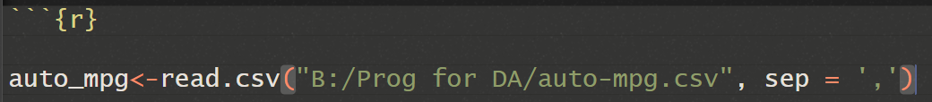

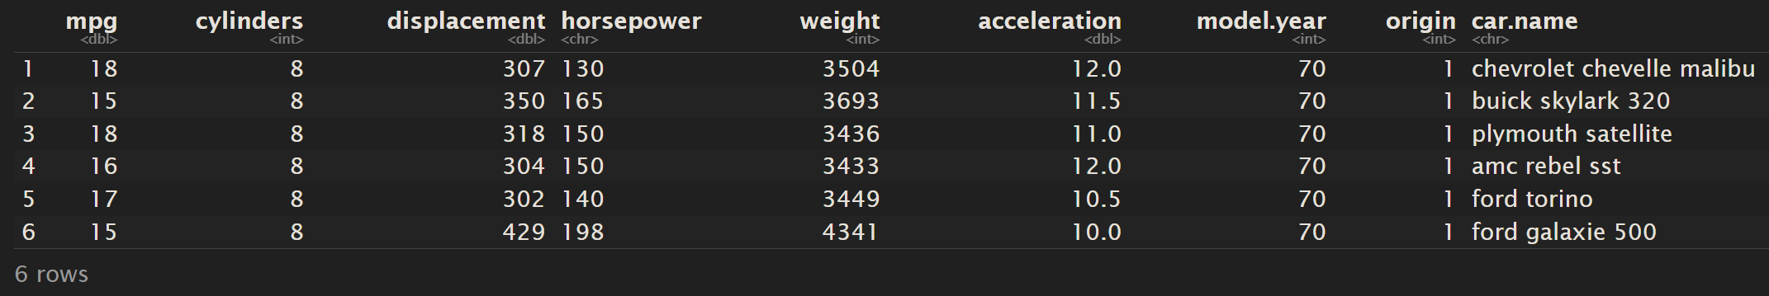
The read.csv() function in R is used to read data from a CSV (Comma-Separated Values) file into a data frame.
This line of code is reading a CSV file named "auto-mpg.csv" from the specified path and storing the data in the R variable called auto_mpg. After running this code, you can use the auto_mpg variable to work with the data from the CSV file in your R environment.
The head() function in R is used to display the first few rows of a data frame. If you execute head(auto_mpg), it will show you the first six rows of the auto_mpg data frame.

Slide 6
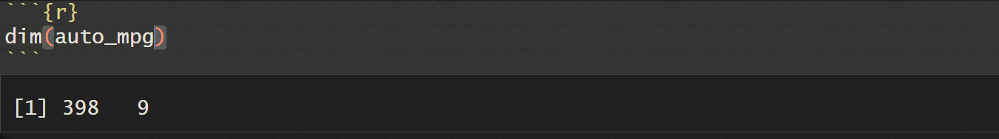
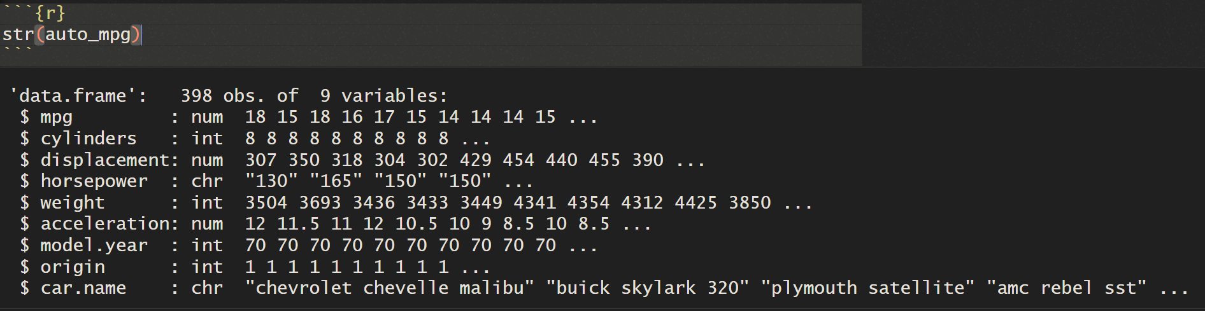
The dim() function in R is used to get the dimensions (number of rows and columns) of an object.
The str() function in R is used to display the internal structure of an R object.

Slide 7
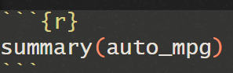
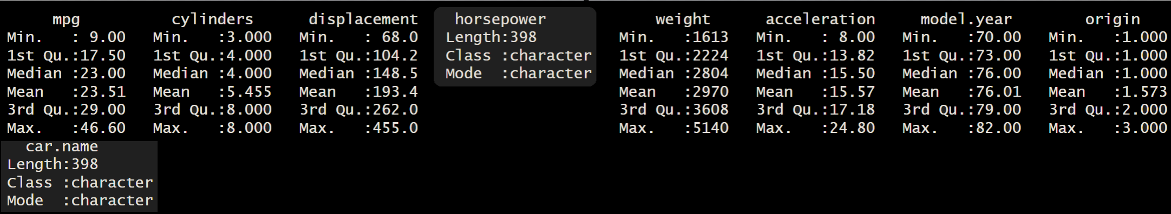
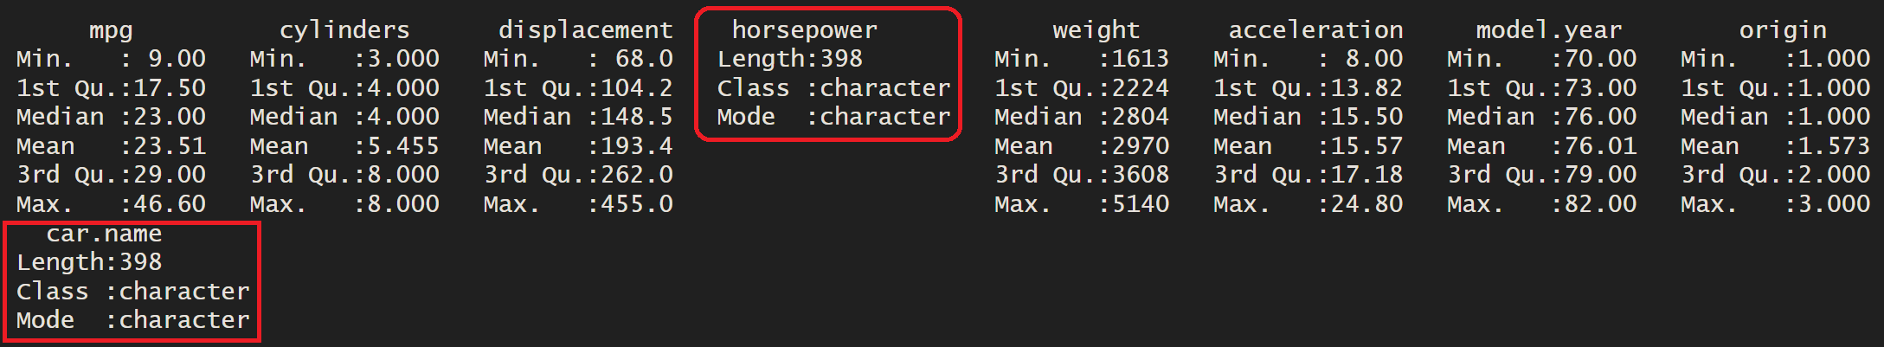
CLEANSING OF DATA
The summary() function in R provides a summary of the contents of a data frame, including descriptive statistics for numeric columns and a count of unique values for categorical columns.
summary(auto_mpg) will give you an overview of the dataset.

Slide 8
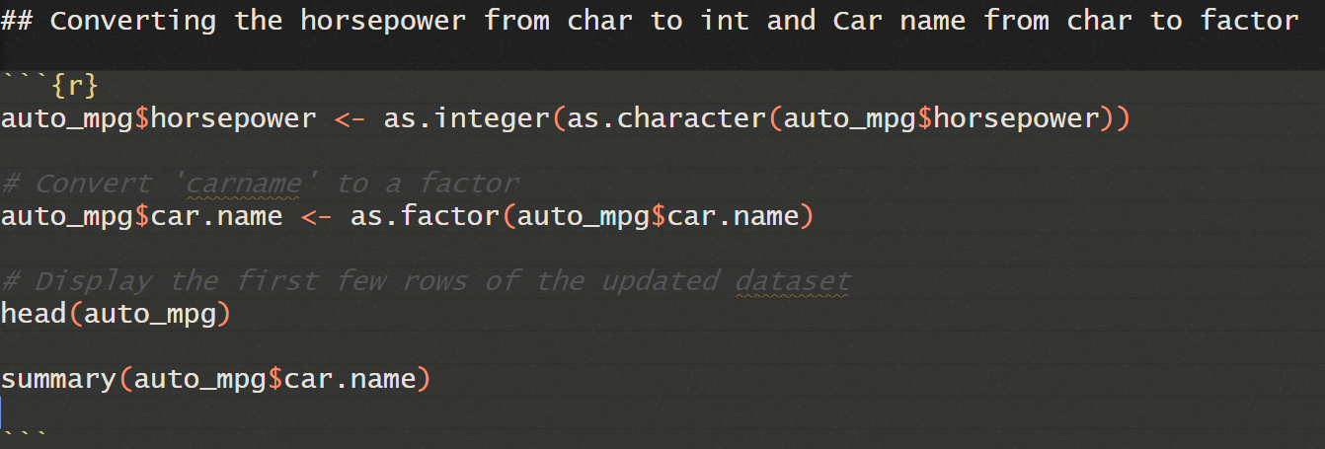
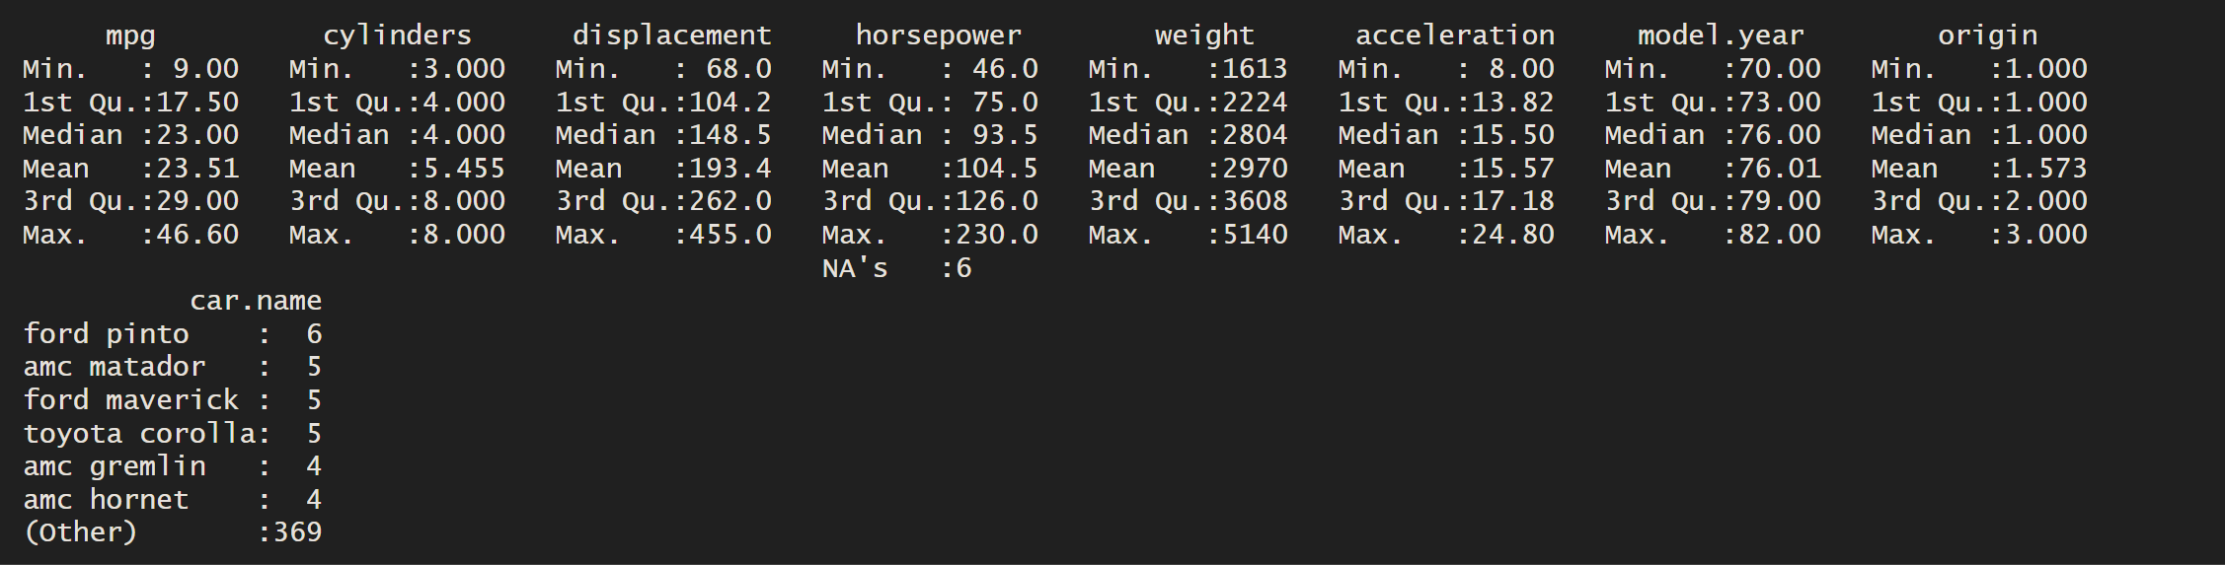
CLEANSING OF DATA

Slide 9
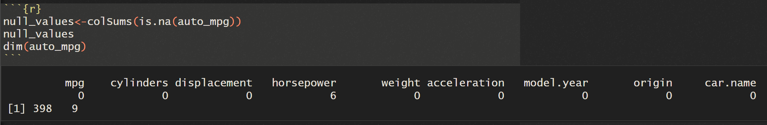
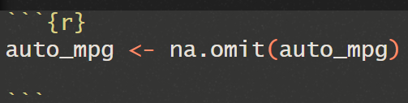
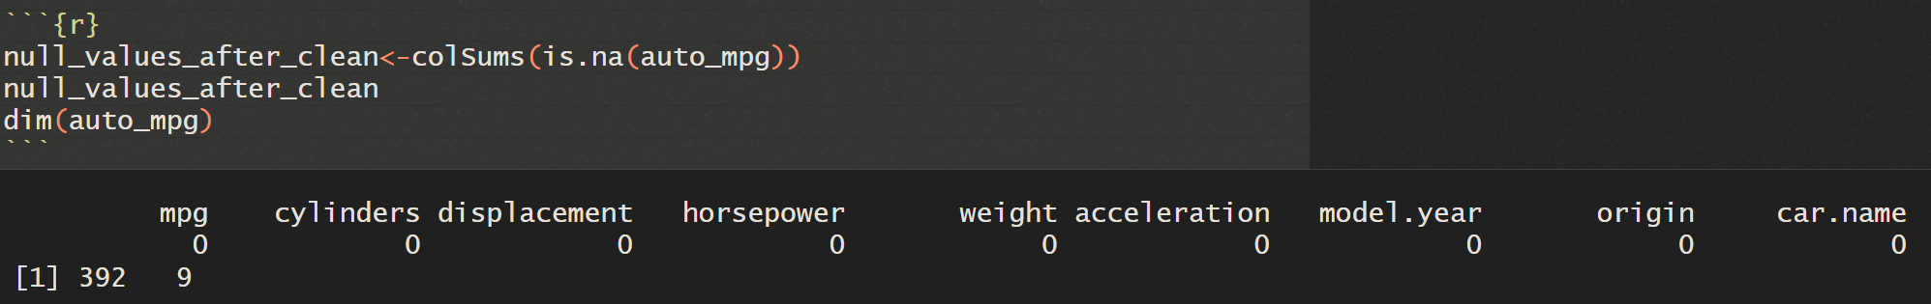
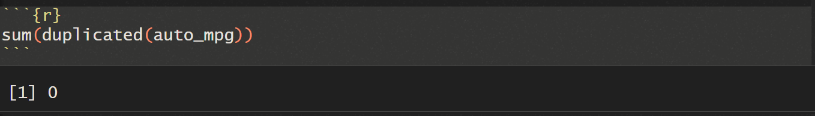
CLEANSING OF DATA
BEFORE
AFTER

Slide 10
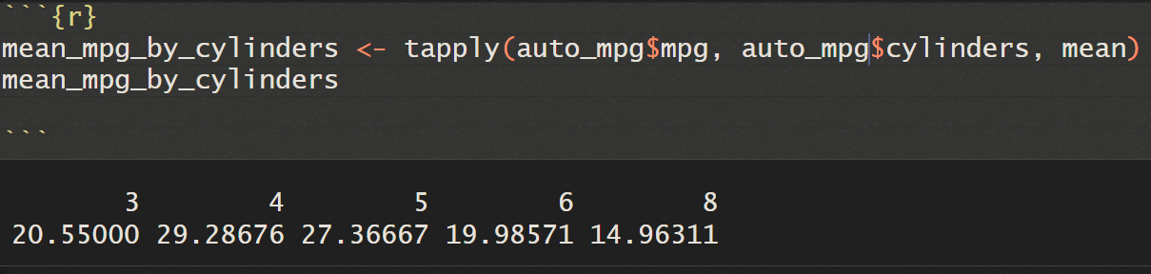
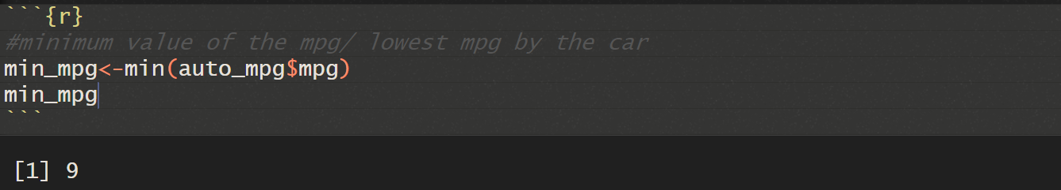
The tapply() function in R is used for applying a function to subsets of a vector, based on a grouping factor.
tapply(data, INDEX, FUN)
To find the minimum Miles Per Gallon (MPG) for all cars in the dataset

Slide 11
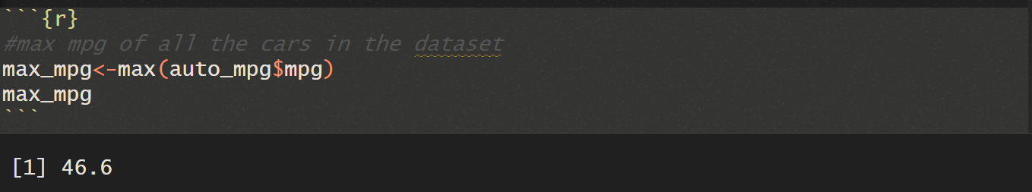
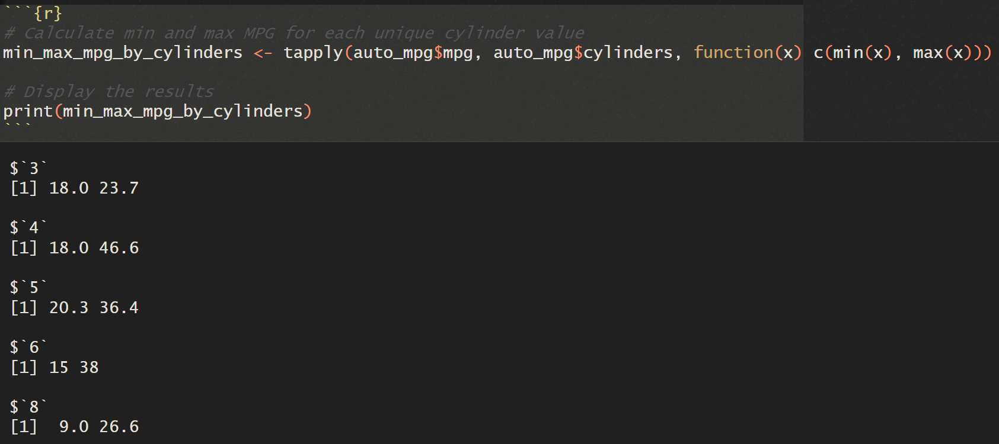
To find the maximum Miles Per Gallon (MPG) for all cars in the dataset
To calculate the minimum and maximum Miles Per Gallon (MPG) for each unique cylinder value,

Slide 12
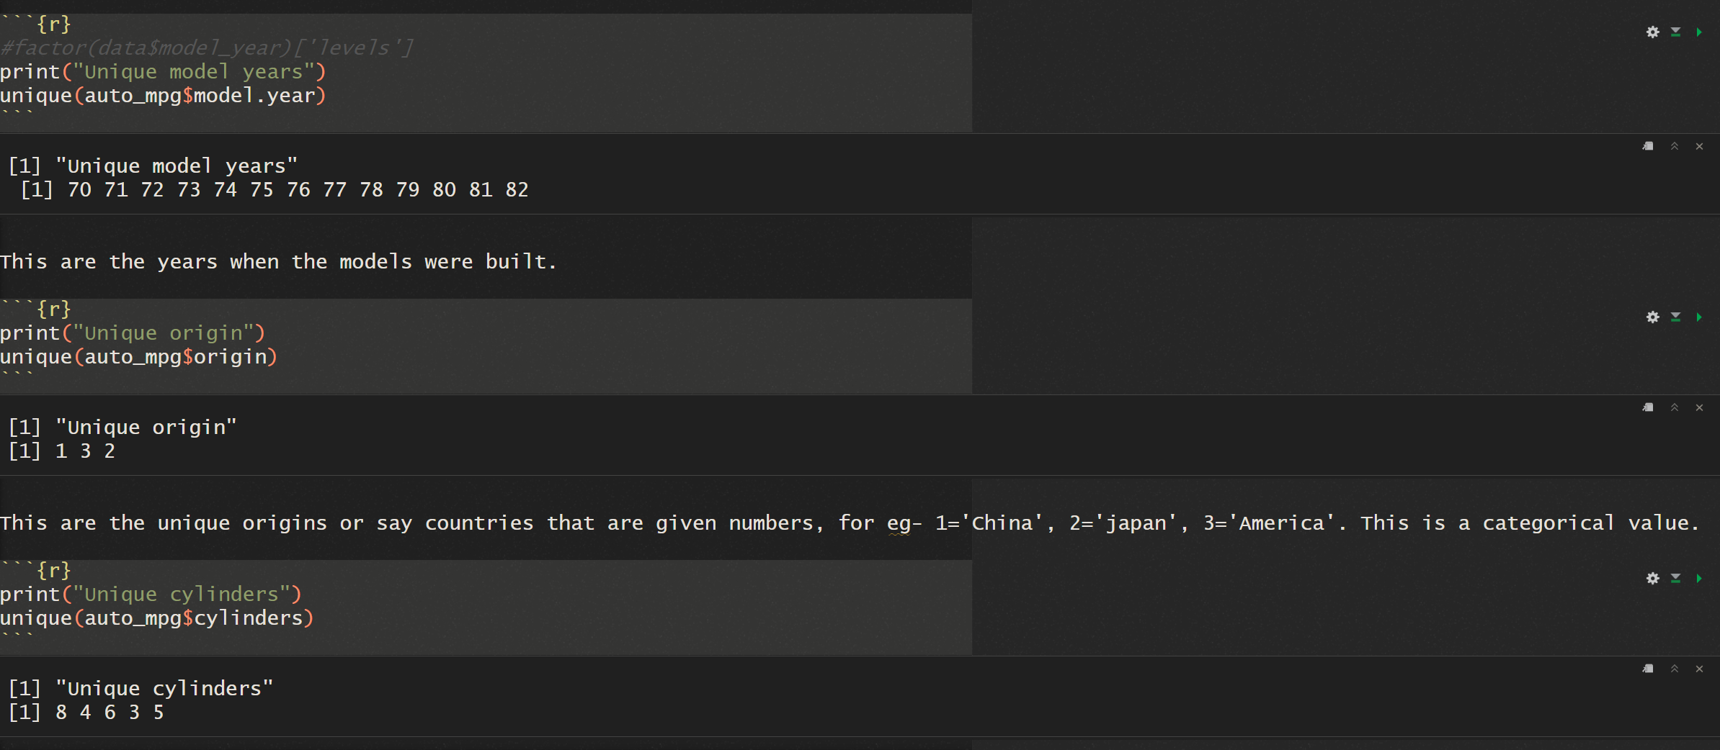
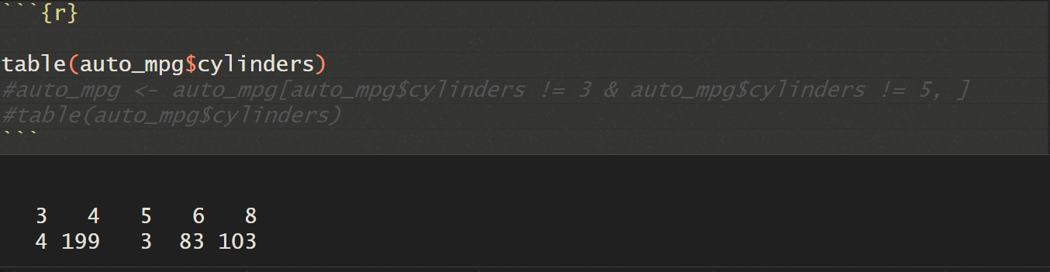
The unique() function in R is used to obtain the unique values of a vector.
The table() function in R is used to create a table of counts of the elements in a vector.

Slide 13
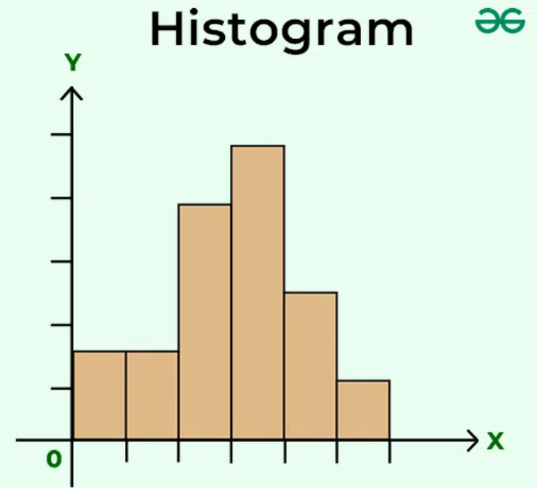
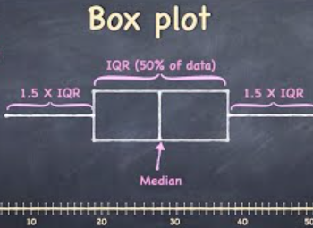
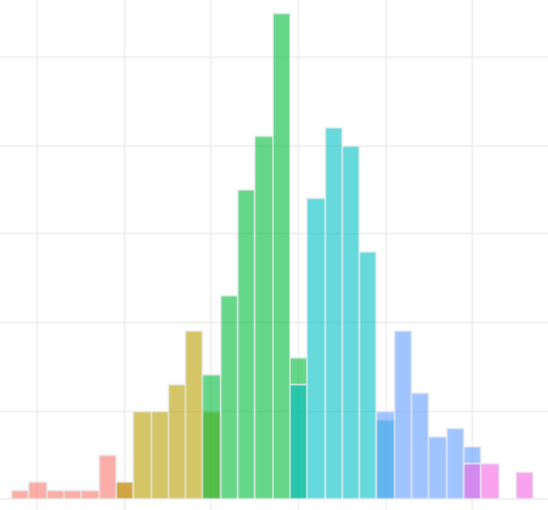
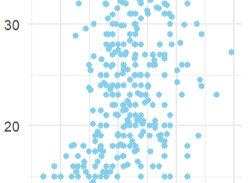
Data Exploration
Data Visualization, with histogram, boxplot, overlay histogram and with our conclusions on each

Slide 14
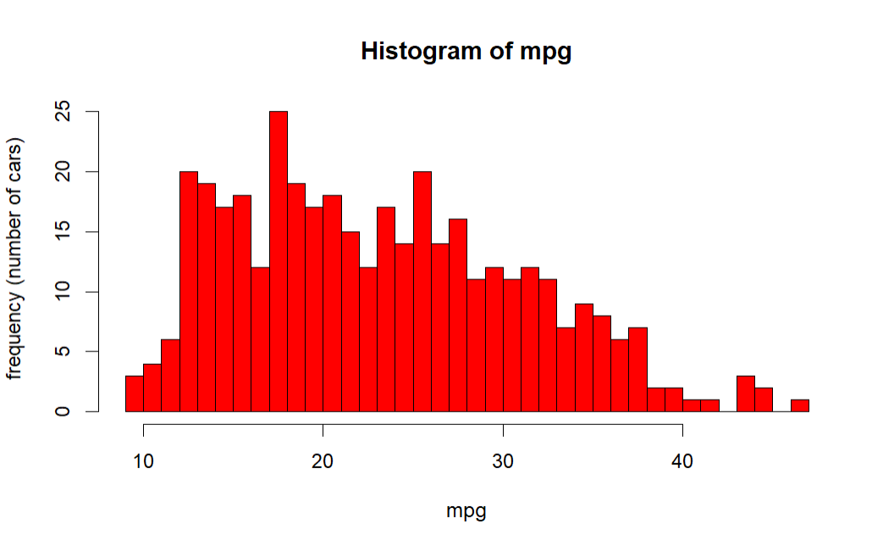
Histogram of MPG to see the distribution of the data

Slide 15
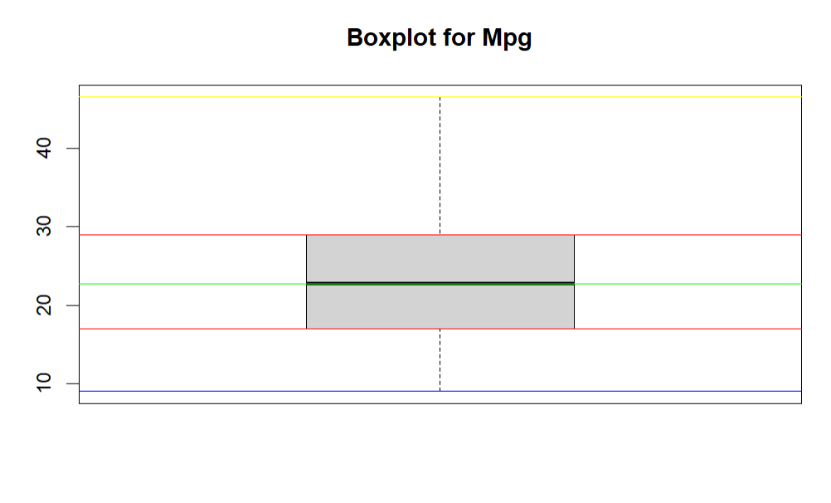
This is a box plot to check if there are any outliers.
We can conclude from the observation that there are no outlier.

Slide 16
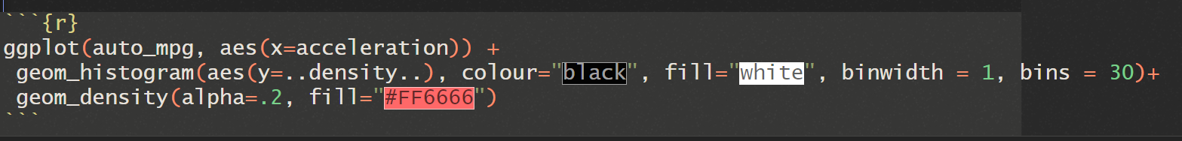
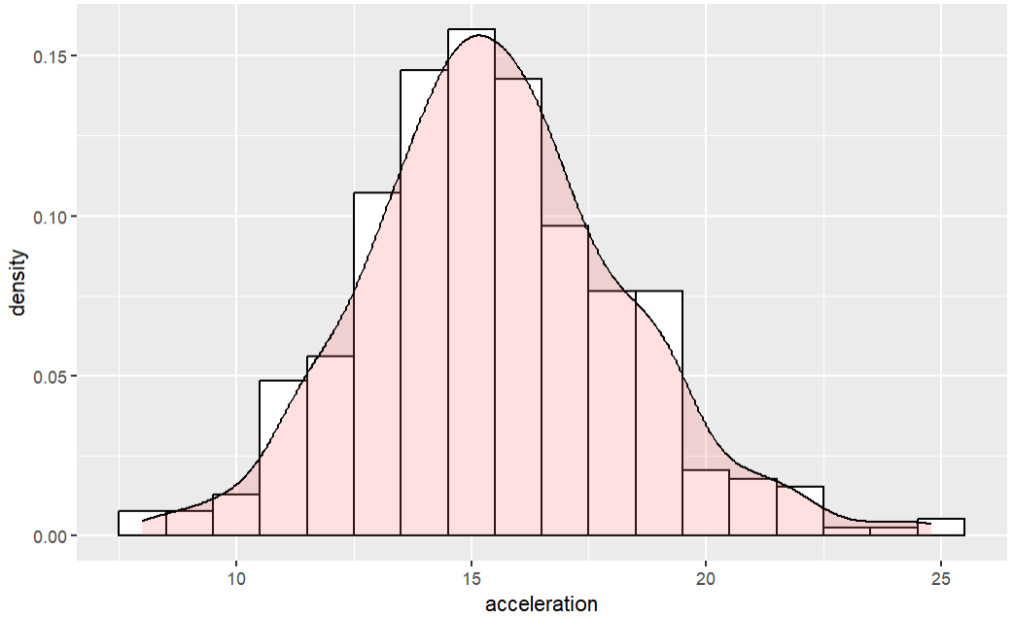
This is a histogram for the acceleration. We can conclude that this is a approximately linearly distributed.

Slide 17
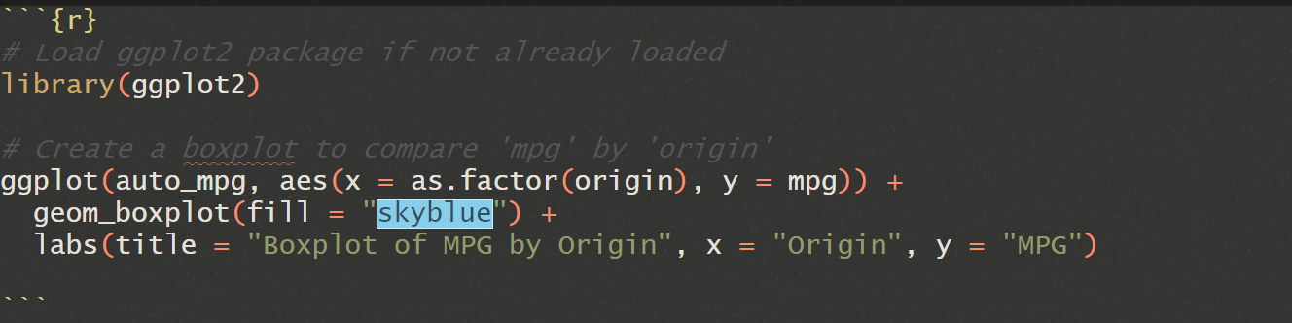
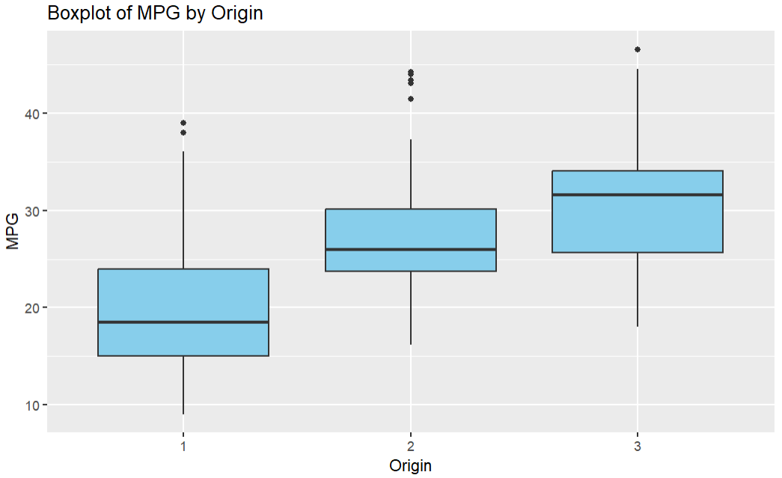
This is a box plot to see the outliers for the origin. We conclude that there are outliers. We can also see that MPG for the cars of origin 3 is greater. There may be many factors that may affect it.

Slide 18
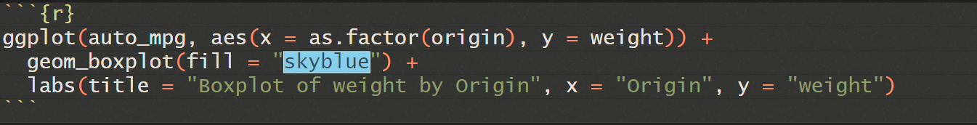
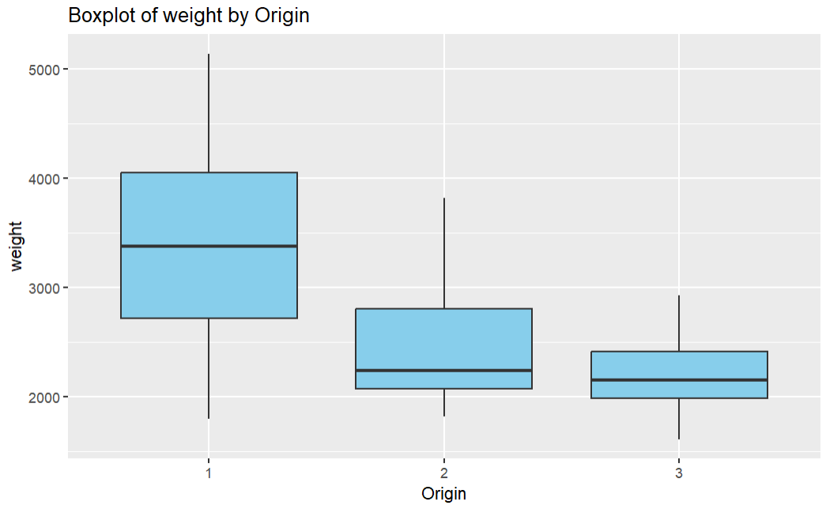
Weight is one of the reasons. The region 3 is having autos with lower weight and with higher mpg as seen above. So we can say that the weight plays imp role in determining mpg.

Slide 19
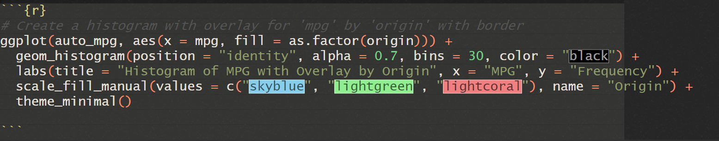
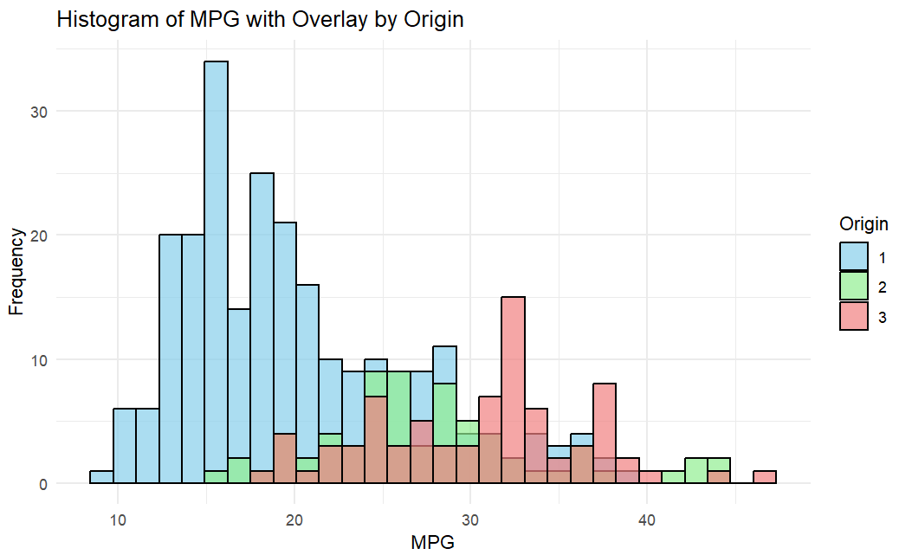
This is an overlay Histogram of MPG and origin.
We see that one value is numeric and other is categorial.

Slide 20
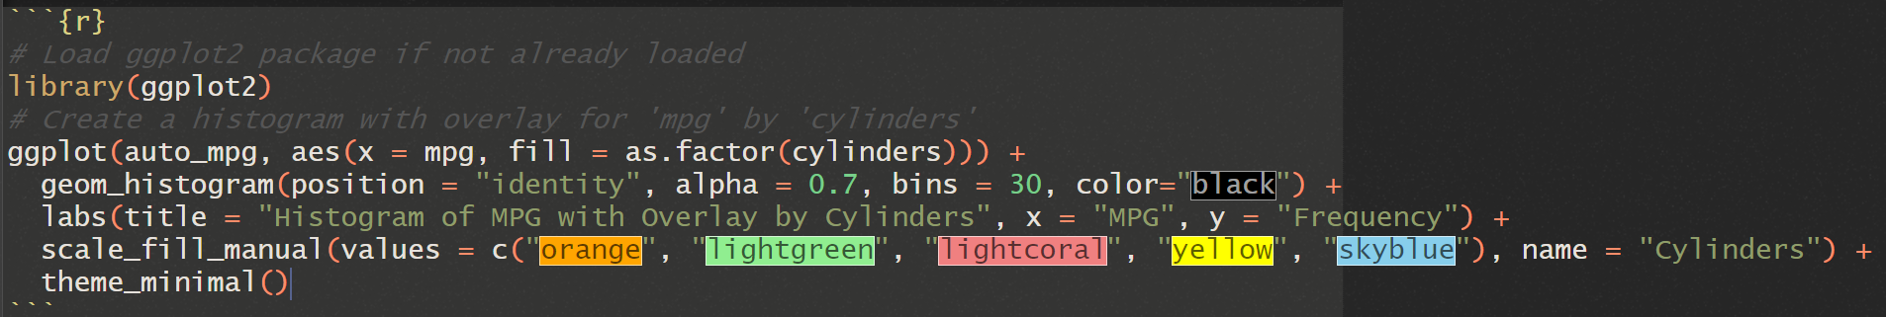
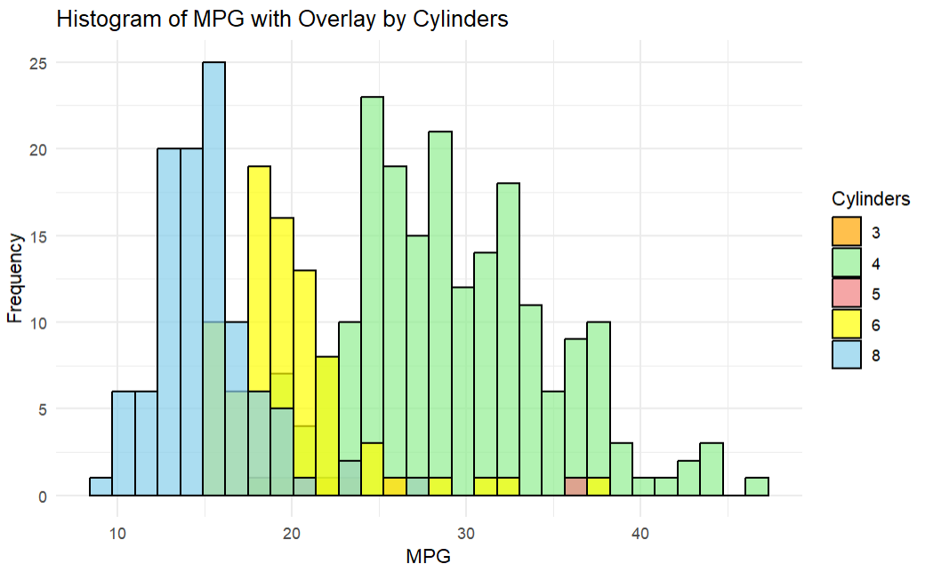
This shows mpg of cars with different cylinders.

Slide 21
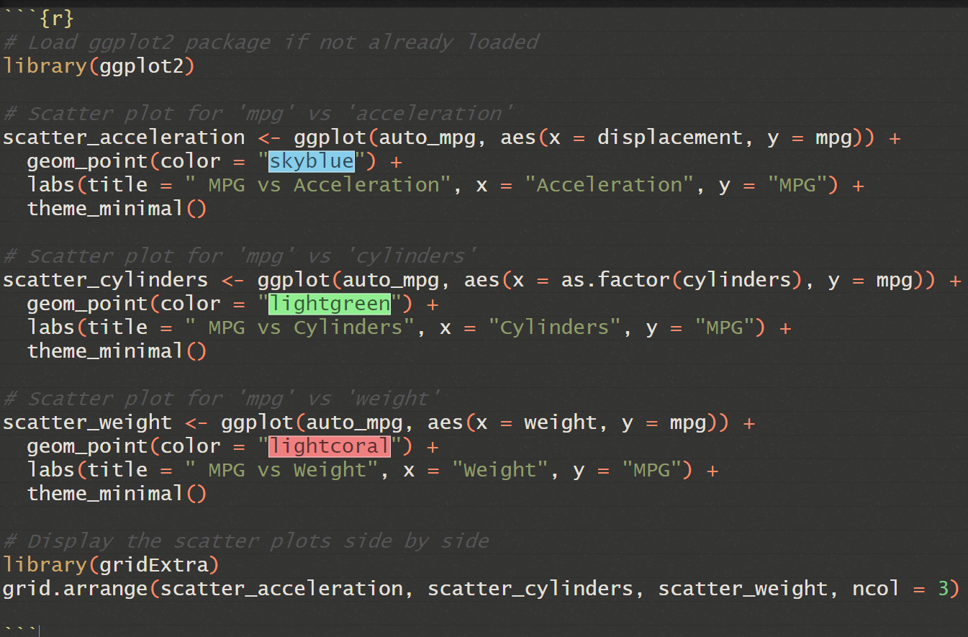
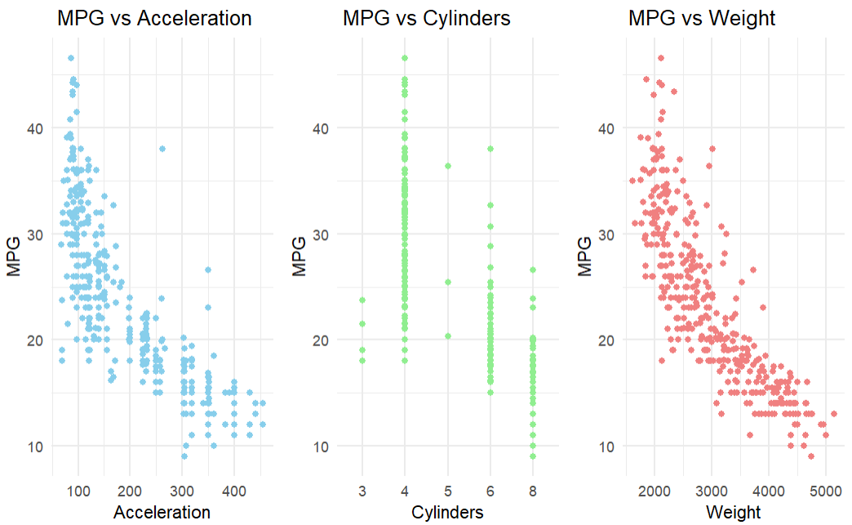
This are the scatterplots that are made to see the relation between mpg and different variables.

Slide 22
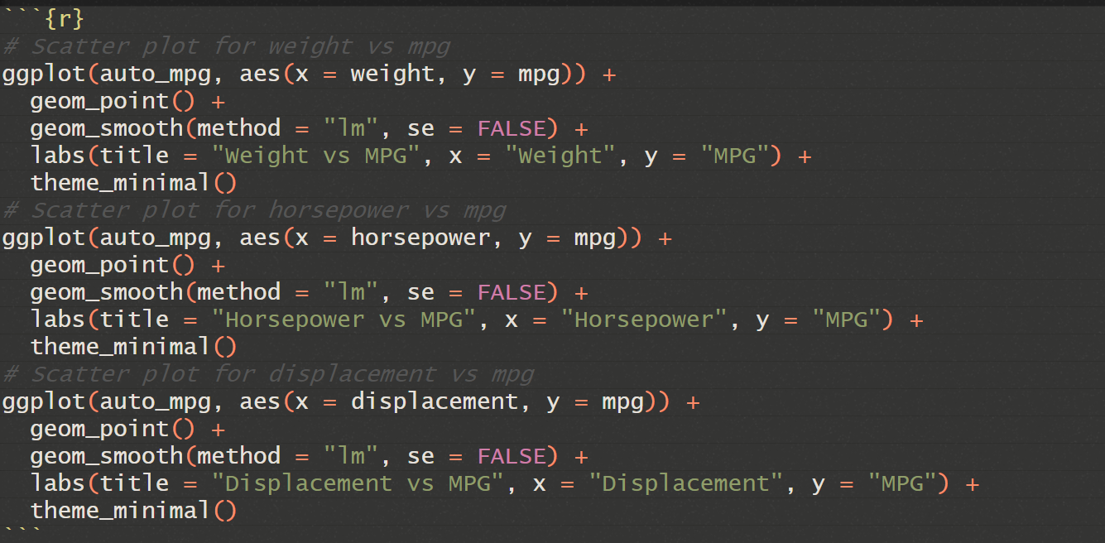
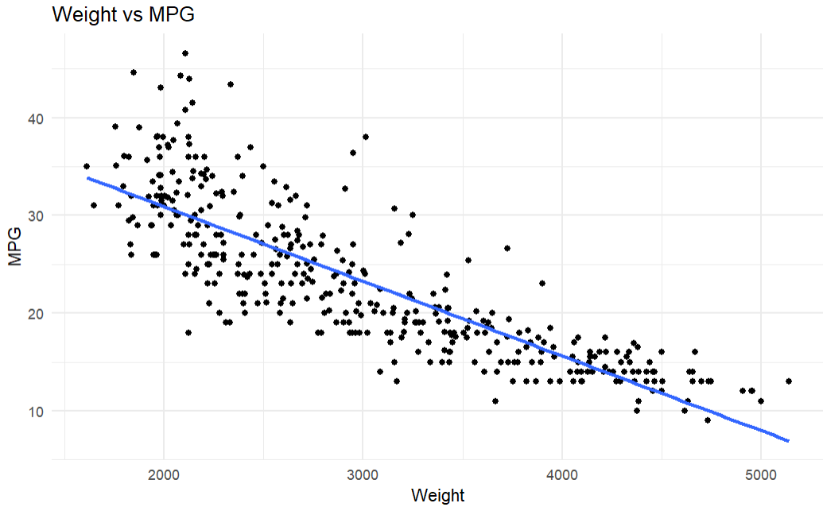
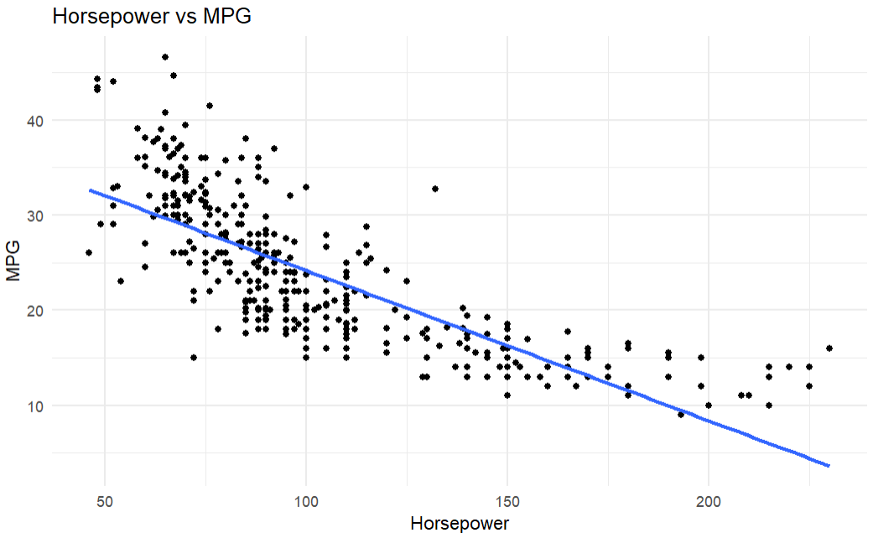
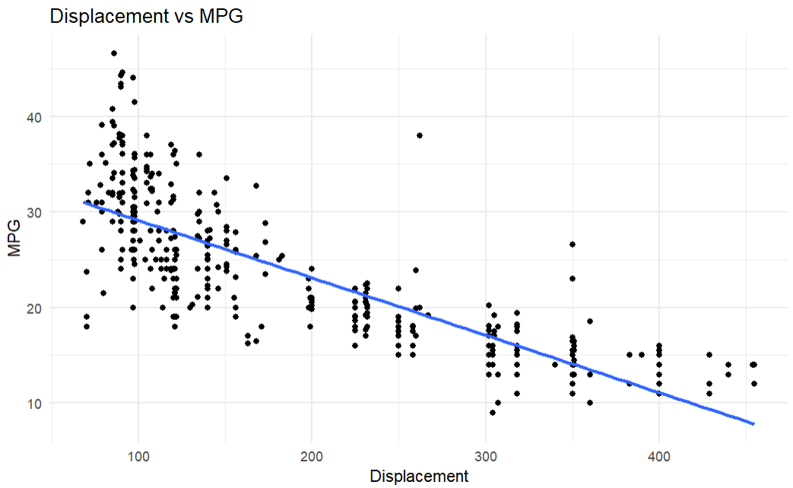
we can see from the figure as the hp, weight, displacement increases the mpg decreases.

Slide 23
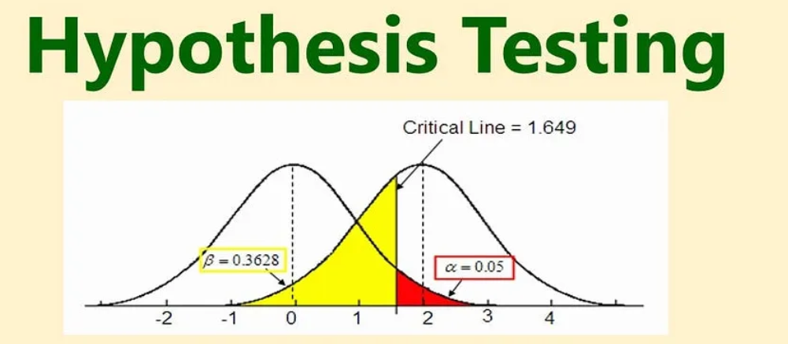
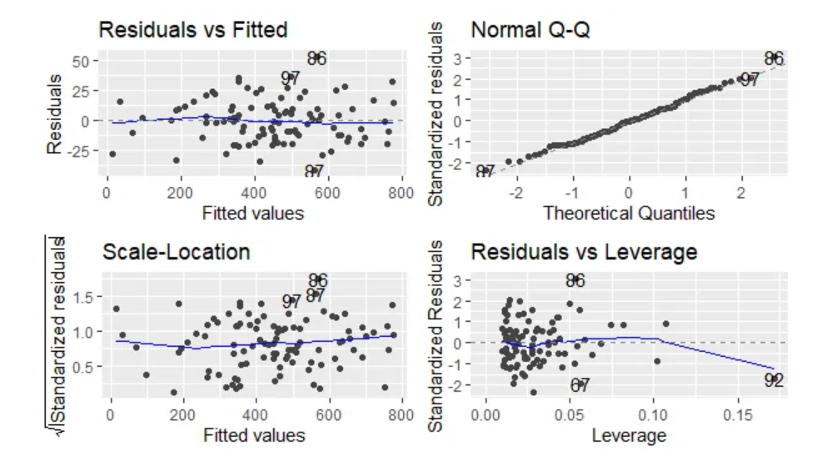
Data Analysis
Hypothesis Testing: Conducting a hypothesis testing with null and alternative hypotheses. Using to get the appropriate test and to get the conclusion.
Building a linear regression model with subset selection. to indicate significant attributes, assess our model, and to predict in a test dataset.

Slide 24
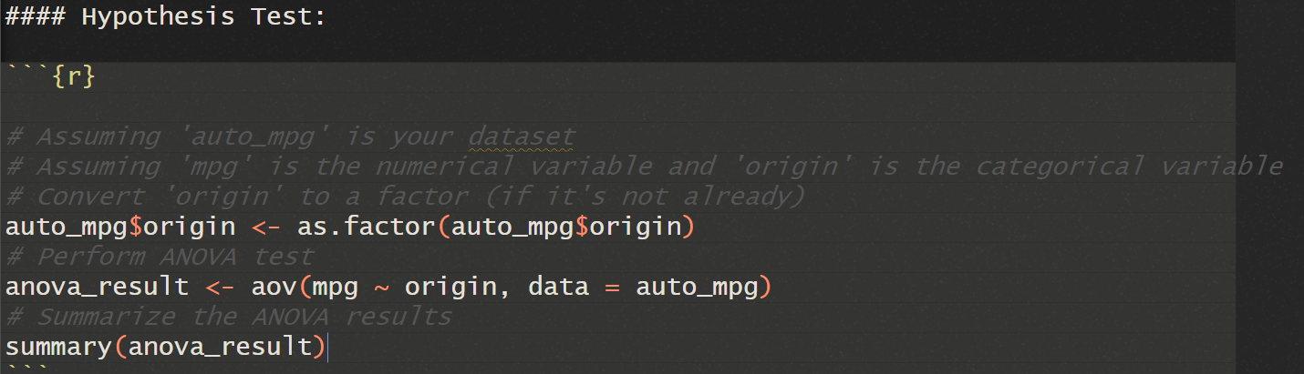
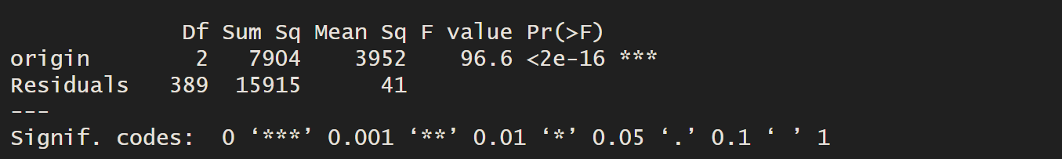
Hypothesis Testing
Null hypothesis: There is no significant difference in MPG between cars from different origins.
Alternative hypothesis: There is at least one significant difference in MPG between cars from different origins.
The ANOVA test performed is a valid way to test for a significant relationship between MPG and the origin of the cars. The ANOVA results show that there is a significant difference in MPG between cars from different origins (p-value < 0.001). This means that we can reject the null hypothesis and conclude that there is at least one significant relationship between MPG and origin.

Slide 25
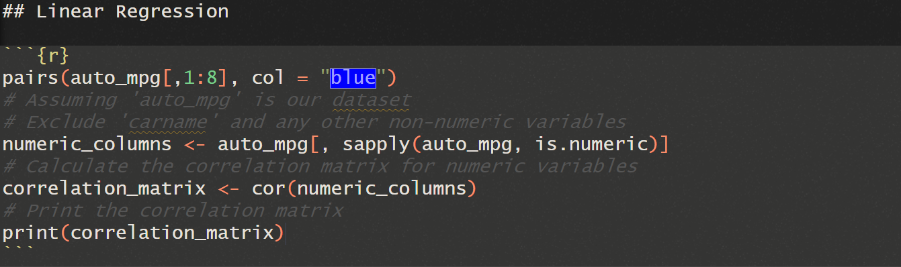
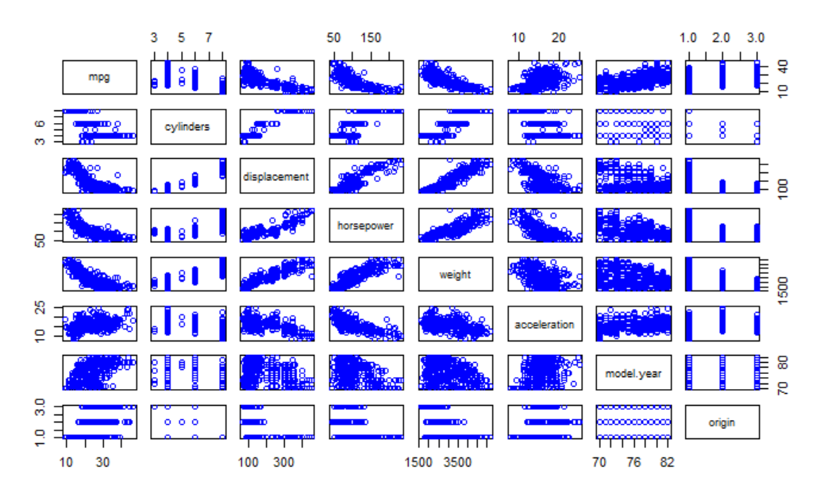
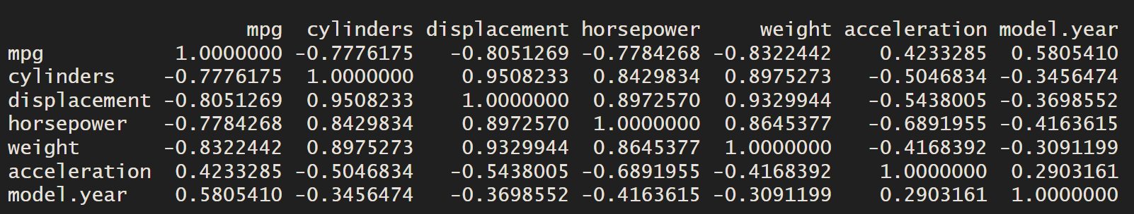
Linear Regression
Pairs function show a us the correlation between the variables.

Slide 26
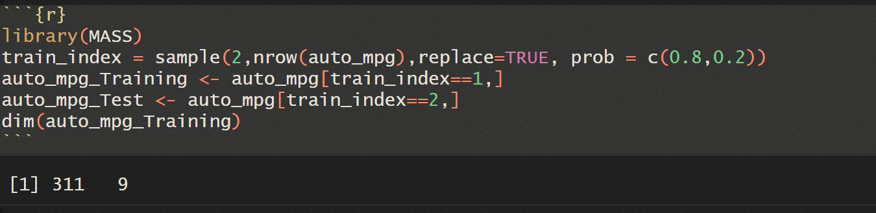
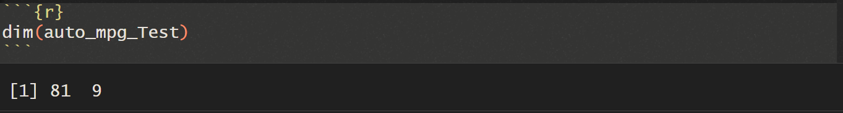
Simple Linear Regression
For Linear Regression, we are going to determine what all factors are dependent on the mpg variable.
we divide the dataset into training(80) and testing data(20).

Slide 27

Dependent variables and Independent variables
Linear Regression Modelling the relationship between dependent variable and one or more independent variables.
In summary, the linear regression model shows that there is a statistically significant relationship between weight and mpg in the auto.

Slide 28

Continuing…
continuing
In summary, the linear regression model shows that there is a statistically significant relationship between horsepower and mpg in the auto.

Slide 29



Continuing…

Slide 30

Multiple Linear Regression
We exclude the variable called car.name.
The model indicates that the contributing factors to mpg are origin, weight, model.year, displacement.

Slide 31

Continuing…
MAE: Mean absolute error, measure of average mistake in a collection of prediction.
MSE: Average squared difference between estimated values and actual value.

Slide 32







Forward stepwise regression

Slide 33



Continuing…

Slide 34




Backward stepwise regression

Slide 35



Continuing…

Slide 36


